Slide 1
Sentiment Classification for Piano Music
Jason Shu, Joseph Poirier, Paul Scott

Slide 2
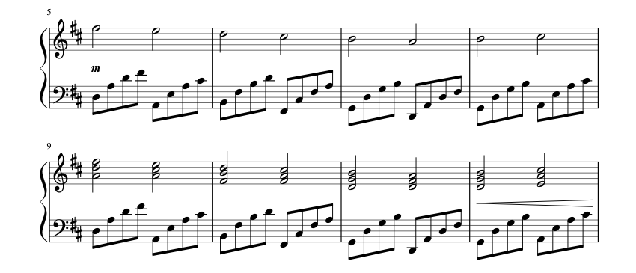
Motivation and Dataset
Our goal was to train models to classify the sentiment of songs
We used a dataset called Maestro, which contains approx. 1200 piano songs in MIDI format
We used the Spotify API to get the sentiment scores for each of the songs
After collected Spotify sentiments and removing songs where no sentiment data was available, we ended up with a dataset of approx. 1000 piano songs with sentiments
https://musescore.com/user/1809056/scores/1019991

Slide 3
Preprocessing
We first loaded the MIDI files and then converted them into a pandas dataframe, where each row is a midi note, with the following columns:
Pitch: Number from 0 to 127 that designates the note pitch
Step: Time difference between start of current note and end of previous note
Multiple sequential notes with step 0 imply that the notes are played together
Duration: How long the note is sustained
We collect three sentiment values using Spotify’s API (all rated on a 0 to 1 scale):
Valence: How happy or sad a song is
Energy: How energetic a song is
Danceability: How danceable a song is

Slide 4
Preprocessing (continued)
We split each sentiment score into three classes, constituting the 33th percentile, 67th percentile, and 100th percentile of the values for each sentiment in the training set
Class labels:
Valence: 0 - Sad, 1 - Neutral, 2 - Happy
Energy: 0 - Not Energetic, 1 - Somewhat Energetic, 2 - Very Energetic
Danceability: 0 - Not Danceable, 2 - Somewhat Danceable, 3 - Very Danceable
Could in theory also just use sentiment values directly, which would turn this into a regression problem, but categorical data allows us to better analyze the results

Slide 5
Models
We have successfully run our dataset on two models (test accuracies):
Logistic Regression:
Valence: 52.58%
Energy: 52.58%
Danceability: 46.95%
LSTM:
Valence: 68.08
Energy: 71.83%
Danceability: 69.48%
We are still experimenting with different models and features:
GRU and RNN, should be easily adaptable from LSTM
Implementing & fine-tuning MIDI-BERT
Adding harmony feature
Adding velocity feature
May try autoML

Slide 6
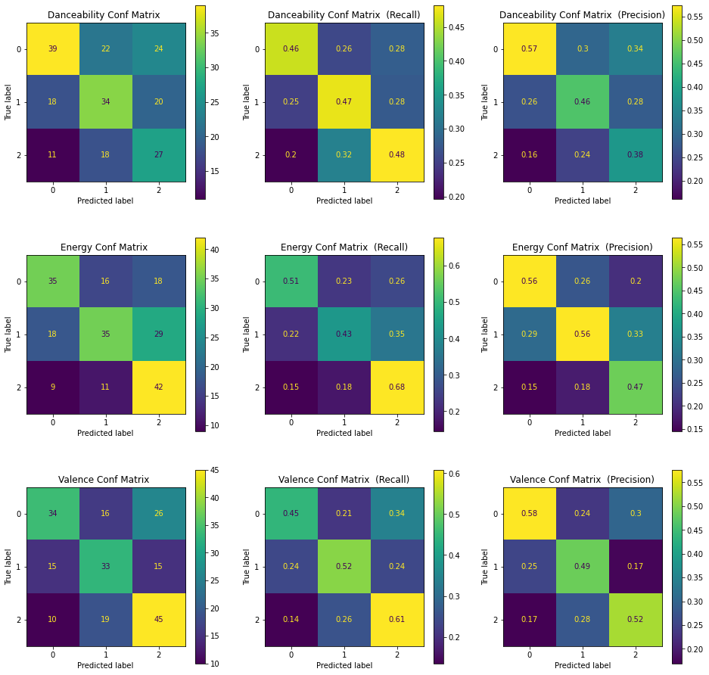
Logistic Regression
Tried multiple values of C penalty:
0.05, 0.1, 0.25, 0.5, 0.75, 1.0, 5.0, 10.0
Optimal C values:
Valence: 0.25
Energy: 0.1
Danceability: 0.25
Results:
Test Accuracies:
Danceability: 46.95%
Energy: 52.58%
Valence: 52.58%
Recall higher than precision (expect for class 2)
Confusion matrices not very clean

Slide 7
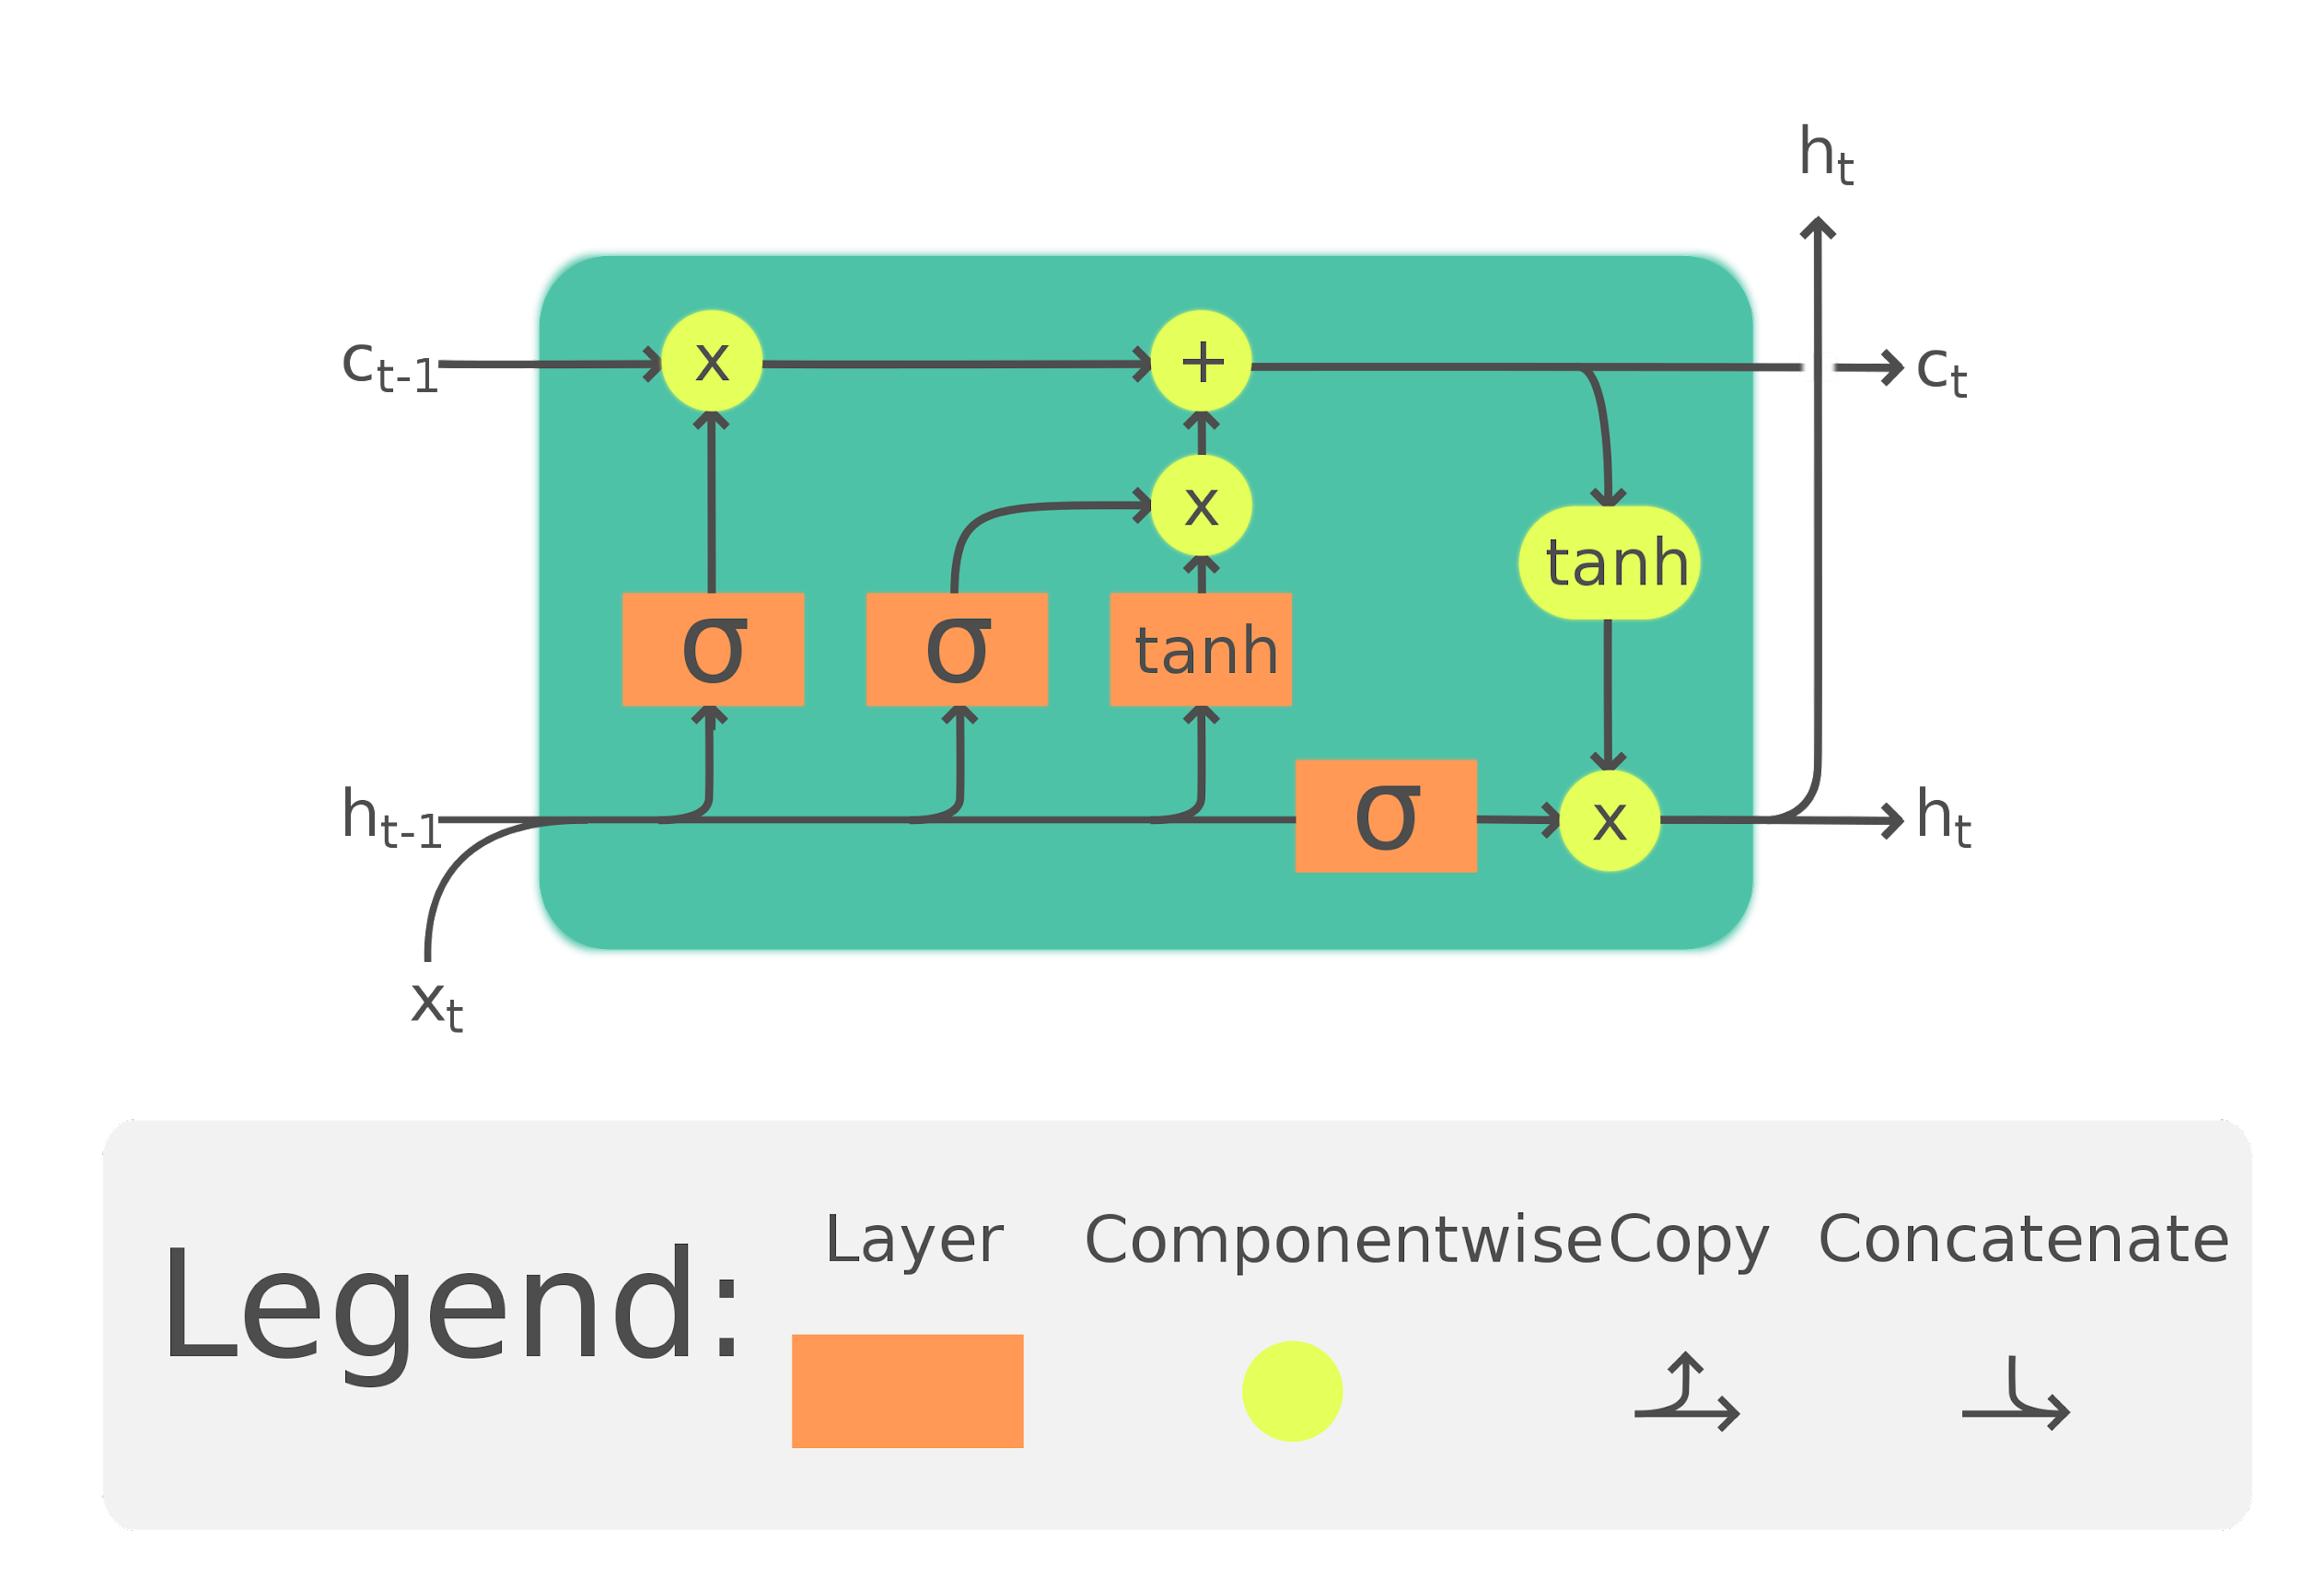
LSTM Model
Tuned hyperparameters over the following options:
Number of LSTM Layers: 1, 2, 3
Number of units per LSTM Layer: 128, 256, 512
Use bidirectional LSTM Layers: False, True
Optimal hyperparameters found using 4-fold cross validation (Layers, Units, Bidirectional):
Valence: 3, 512, True
Energy: 3, 256, True
Danceability: 3, 512, True
https://en.wikipedia.org/wiki/Long_short-term_memory#/media/File:LSTM_Cell.svg

Slide 8
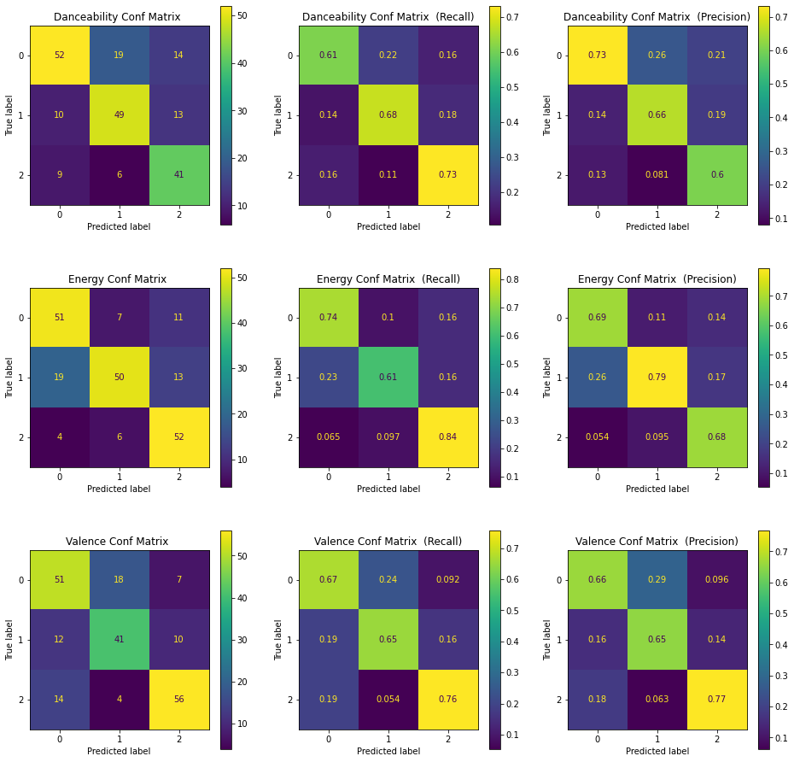
LSTM Model (continued)
Employed early stopping by monitoring the test accuracy during training
Results:
Test accuracies:
Valence: 68.08%
Energy: 71.83%
Danceability: 69.48%
Small differences between precision and recall
Bidirectional LSTMs gave better results
More LSTM layers and units per layer gave better results
Far better performance than Logistic Regression

Slide 9



LSTM Results
Valence: Sad
Valence: Neutral
Valence: Happy

Slide 10
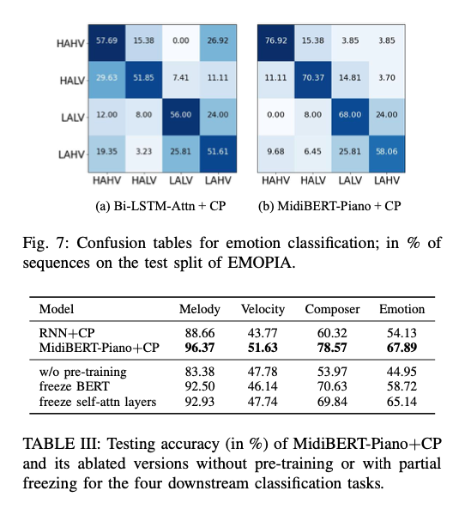
Fine-Tuning MIDI-BERT (Ongoing)
Fundamental idea: treat MIDI music as a “language”.
Twelve-layer transformer model, used to create context-sensitive MIDI sequence embeddings.
Pretrained model trained on 4,166 pieces of polyphonic piano MIDIs using mask-language modeling (MLM)
Originally used for four tasks: melody extraction, velocity prediction, composer classification, and emotion classification.
Problem: embedding requires all notes in sequence. Can we combine embeddings of chords so that they exist in one timepoint?
Original paper: https://arxiv.org/pdf/2107.05223.pdf

Slide 11
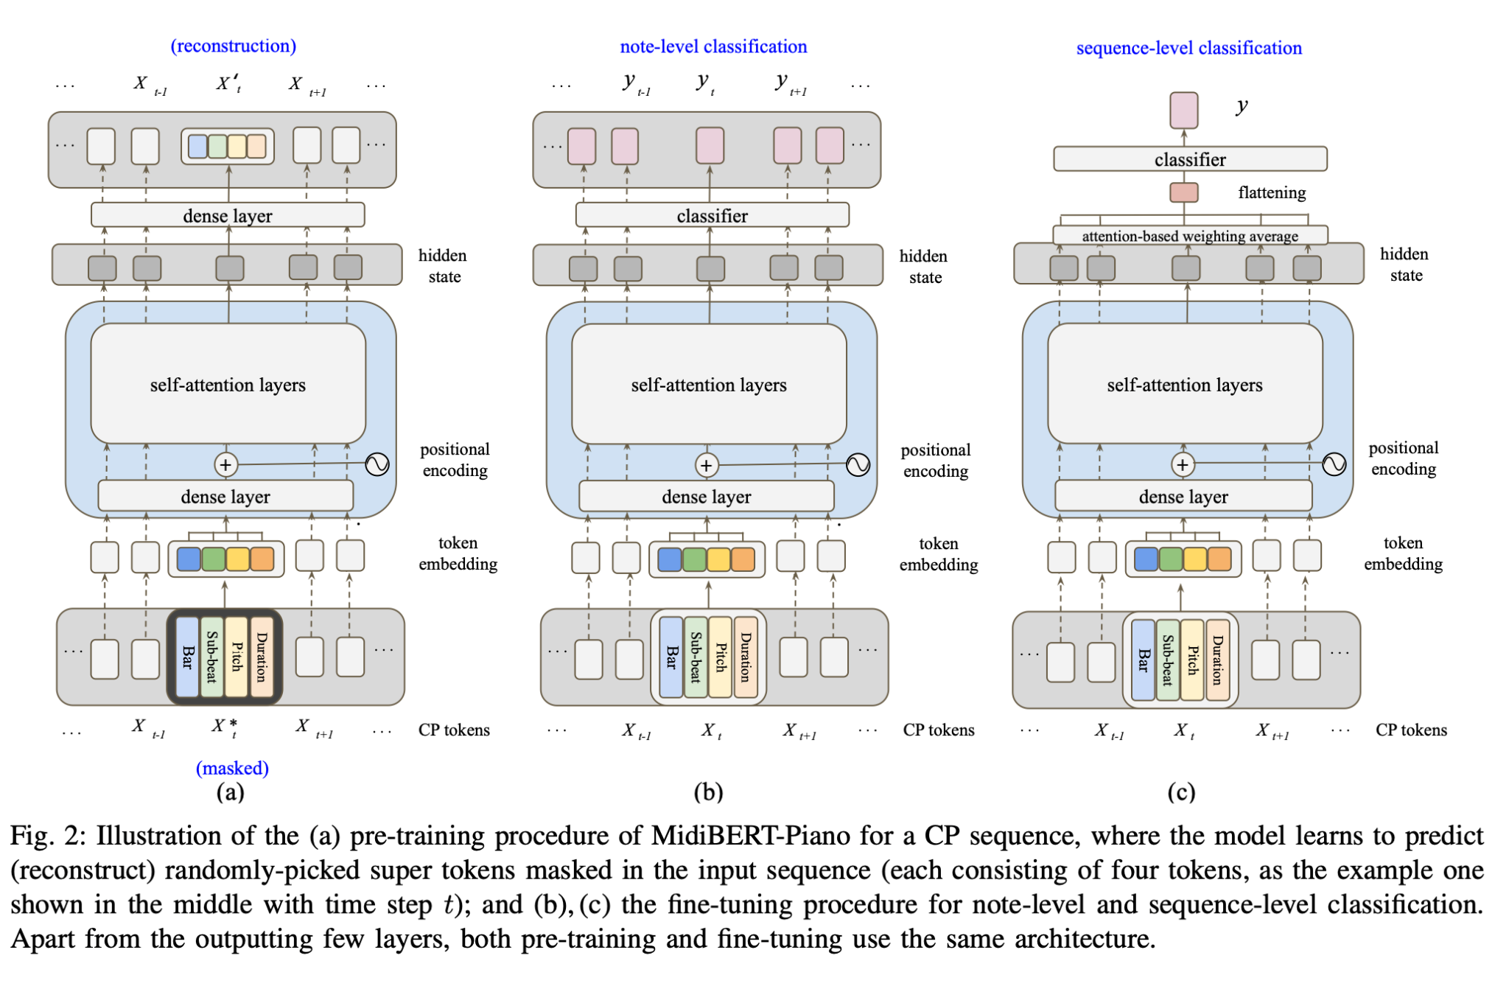

Slide 12
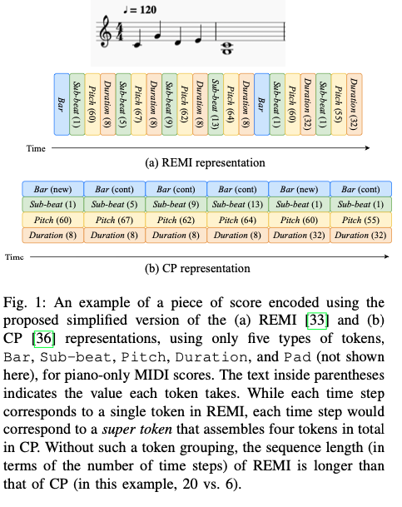
Can We Use Attention to Improve Accuracy?
Transfer learning based on MIDI-BERT would allow us to draw on generalized insights about patterns in MIDI music.
Attention will help in recognizing that transpositions and elongations in musical sequences often don’t have a significant impact on sentiment.
Challenge 1: tokenization of MIDI music — must take temporal position and length, intensity into account.
Challenge 2: emotion BERT was trained on Japanese anime and K-Pop data, and with different metrics.
REMI and CP are two token representations from literature. Preprocessing our data into one of these formats has been challenging.
https://arxiv.org/pdf/2107.05223.pdf

Slide 13
Trying to Incorporate Harmony (ongoing)
Previously, we considered notes sequentially, one-by-one through time
In music, this corresponds to melody
However, pianists have 10 fingers which can play different things at once! So in addition to looking at the notes horizontally (along the time axis), we should look vertically (along the pitch or frequency axis)
This corresponds to harmony
Just feeding our model the notes as they appear sequentially is working okay, but can we include harmony as an attribute?
The idea is take vertical slices of the music and figure out what notes are appearing at that time, together
The machine may note that certain notes appearing together (chords) indicate certain moods!

Slide 14
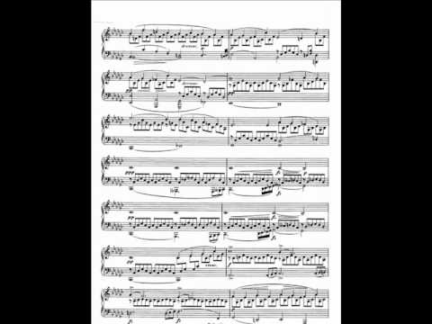
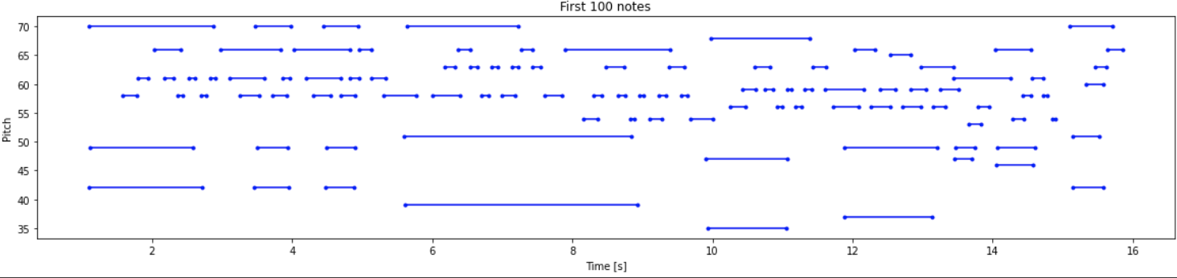
Two problems
Expectation
Reality

Slide 15
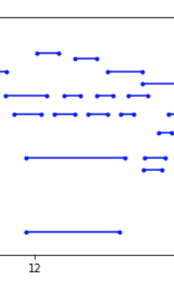
Two problems
When there are lots of notes overlapping, how do we determine which are the most important?

Slide 16
Some attempts at a solution (results pending)
General idea:
Temporarily categorize all notes by their pitch class (C, C-sharp, D, D-sharp, E, etc.), of which there are 12
For each note, record the top k (maybe 2 or 3) pitch classes which overlap with it the longest (filtering out non-chord tones)
Encode those overlapping pitch classes with either “k-hot encoding” or converting to a string and using word2vec/other embedding solutions
We are essentially finding way to encode the harmonic context (chord) of each note
Include the chord encoding as an attribute of the note (like its pitch, duration, etc.) before feeding to model
Limitations?
Music theory is complicated, especially to dictate to a machine (but also for humans)!
Our performances are highly expressive and artistic… and make for dirty data

Slide 17
Conclusions
Models designed for sequential data work better than simpler models like logistic regression (not very shocking)
While the LSTM model is not perfect, it still does a decent job of classifying songs by their sentiment.
Because we used exclusively piano music in our dataset, there is no guarantee that our models will work with other kinds of music

